Slide 1
Change Point Detection DD2 Only
Adam Yang
7/13/2021

Slide 2
parameter | lot_id of change | Date of change
Cap_N_type_EG_20_150_230_14000_Cinv@1.8V_M1 | AZAAD | 3/15/21
Cap_N_type_EG_20_150_230_14000_Cov_M1 | AZAAD | 3/15/21
Cap_P_type_EG_20_150_230_14000_Cinv@1.8V_M1 | AZAAD | 3/15/21
CAP_P_ULVT_4_150_230_7700_Ij_M1 | AZAAD | 3/15/21
CAP_P_LVT_20_200_280_LB_20400_Ij_M1 | AZAAD | 3/15/21
Cap_N_type_LVT_3_8_60_162000_Iginv@1V_M1 | A1AVU | 4/15/21
Cap_N_type_LVT_20_200_280_20400_Iginv@1V_M1 | A1AVU | 4/15/21
DLW_N_EG_150_230_DDB_4_Ilow@1.8V_M1 | AZAF2 | 4/30/21
DLW_N_EG_200_280_DDB_4_Ilow@1.8V_M1 | AZAF2 | 4/30/21
DLW_N_EG_200_280_DDB_4_Vtlin_M1 | AZAF2 | 4/30/21

Slide 3
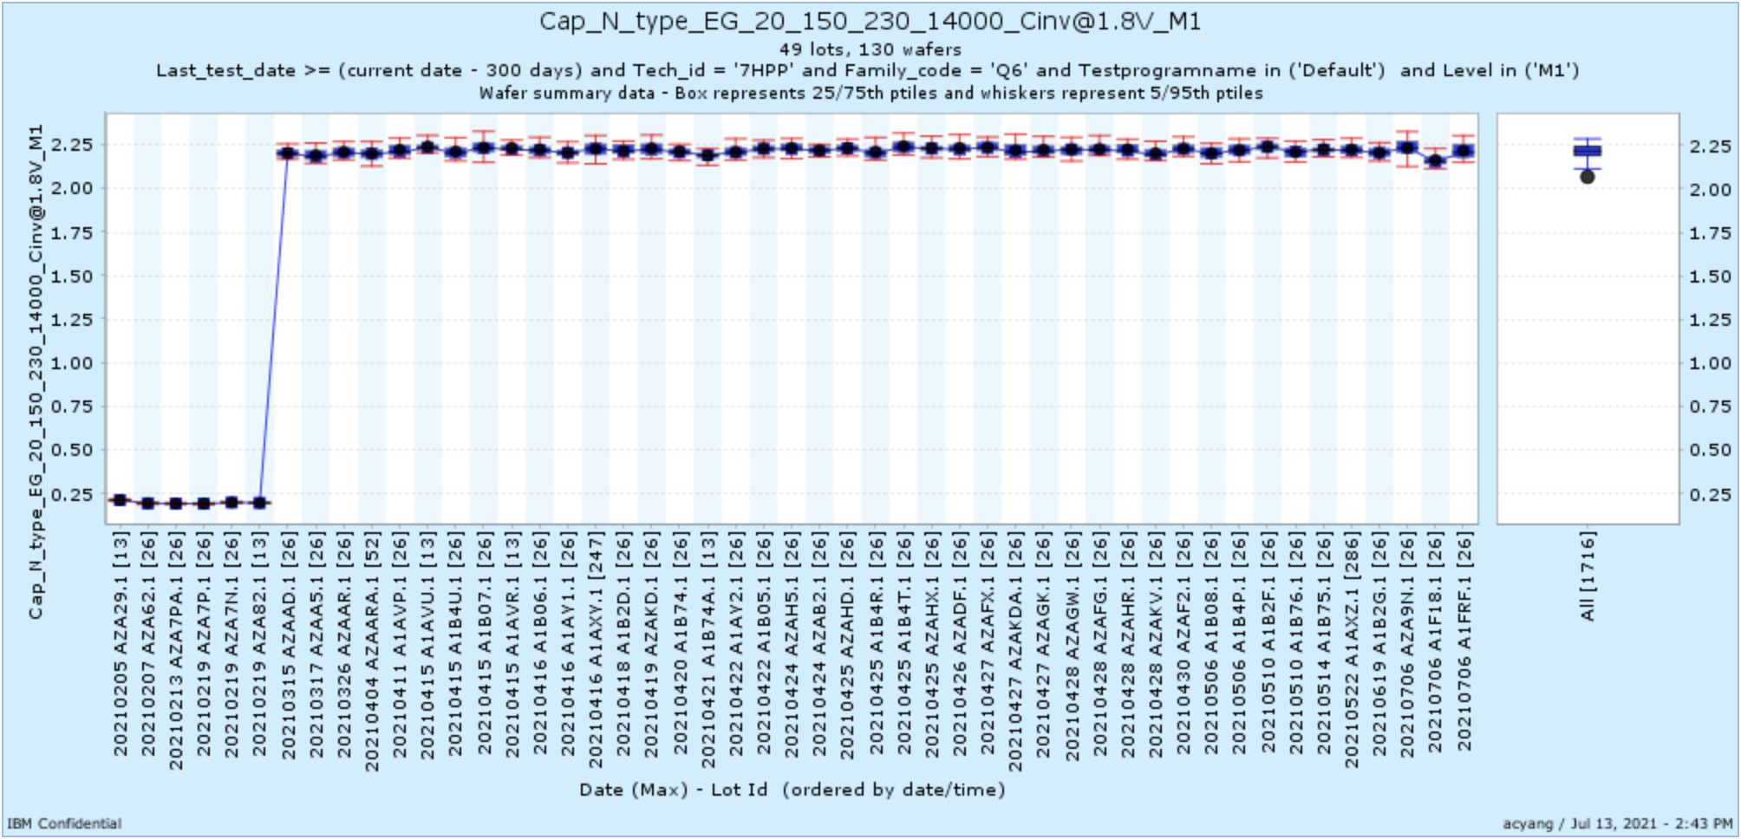
Cap_N_type_EG_20_150_230_14000_Cinv@1.8V_M1

Slide 4
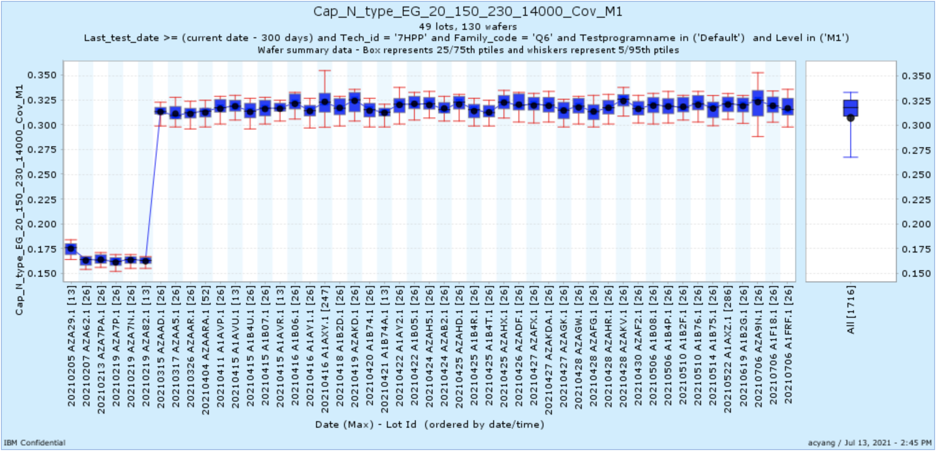
Cap_N_type_EG_20_150_230_14000_Cov_M1

Slide 5
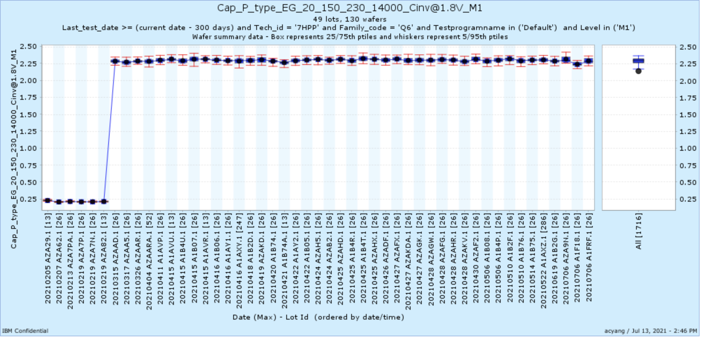
Cap_P_type_EG_20_150_230_14000_Cinv@1.8V_M1

Slide 6
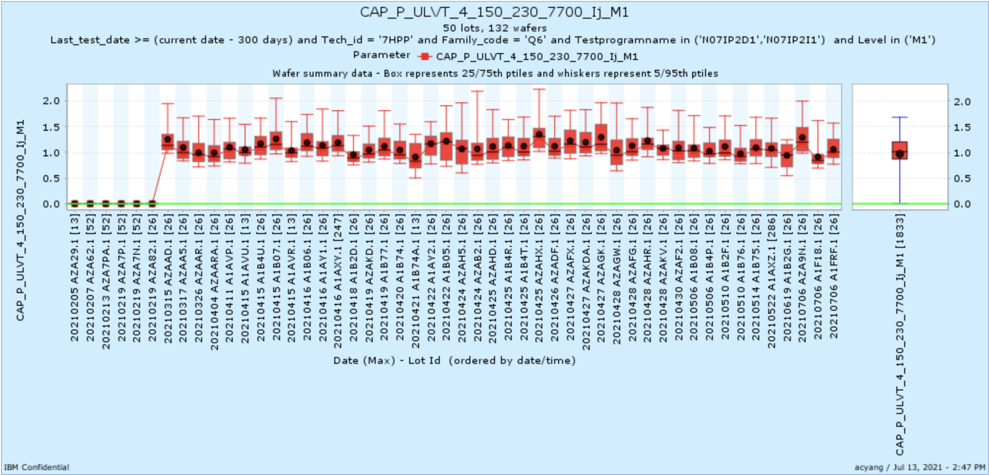
CAP_P_ULVT_4_150_230_7700_Ij_M1

Slide 7
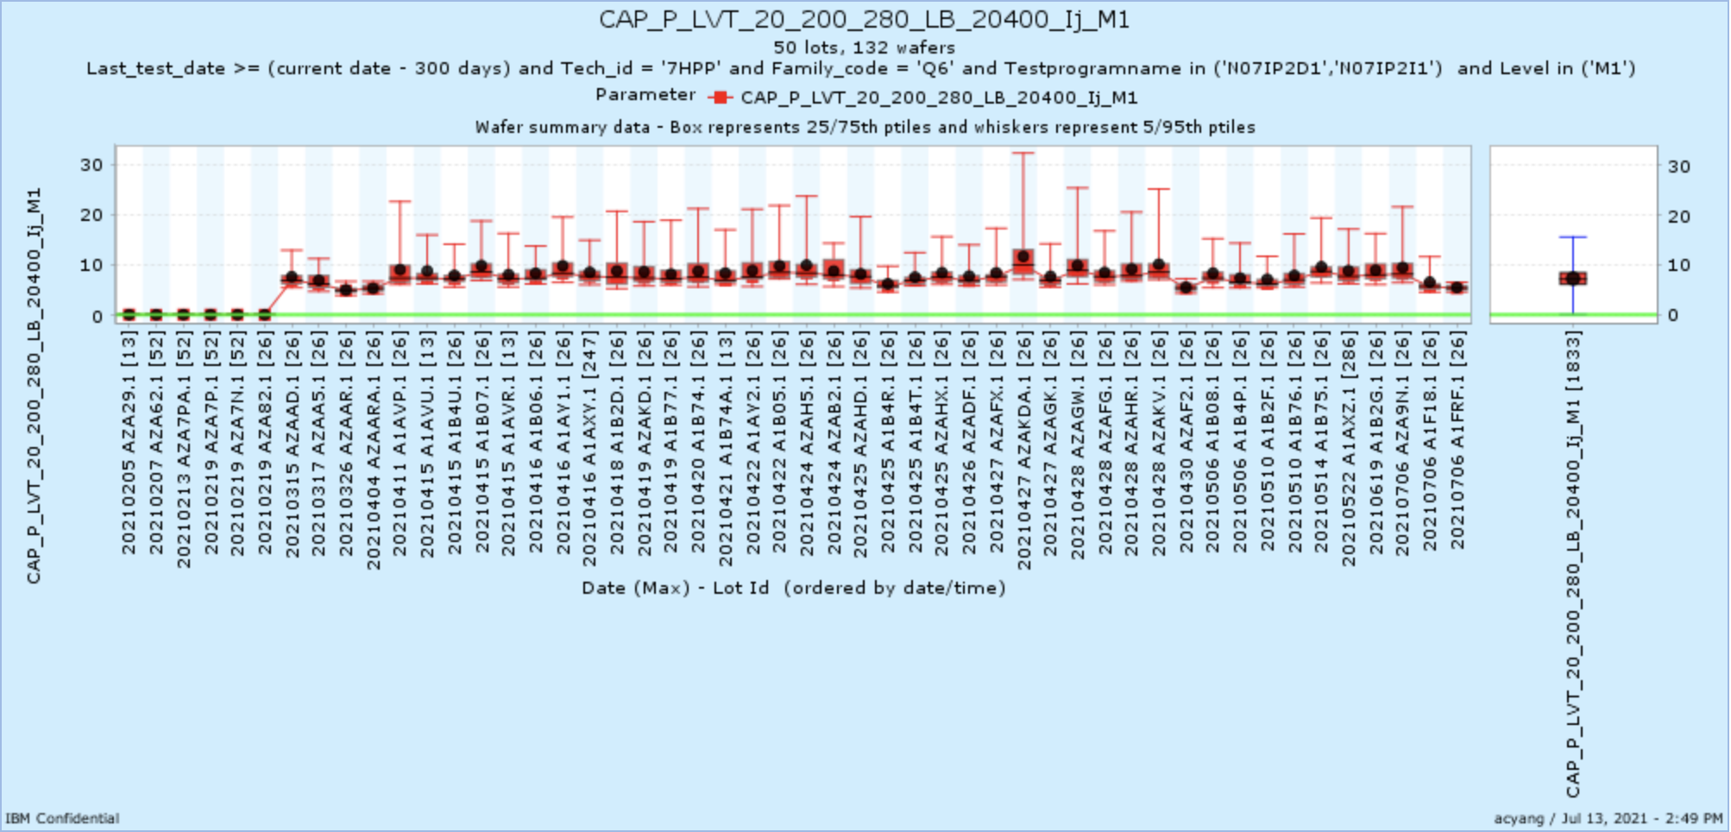
CAP_P_LVT_20_200_280_LB_20400_Ij_M1

Slide 8
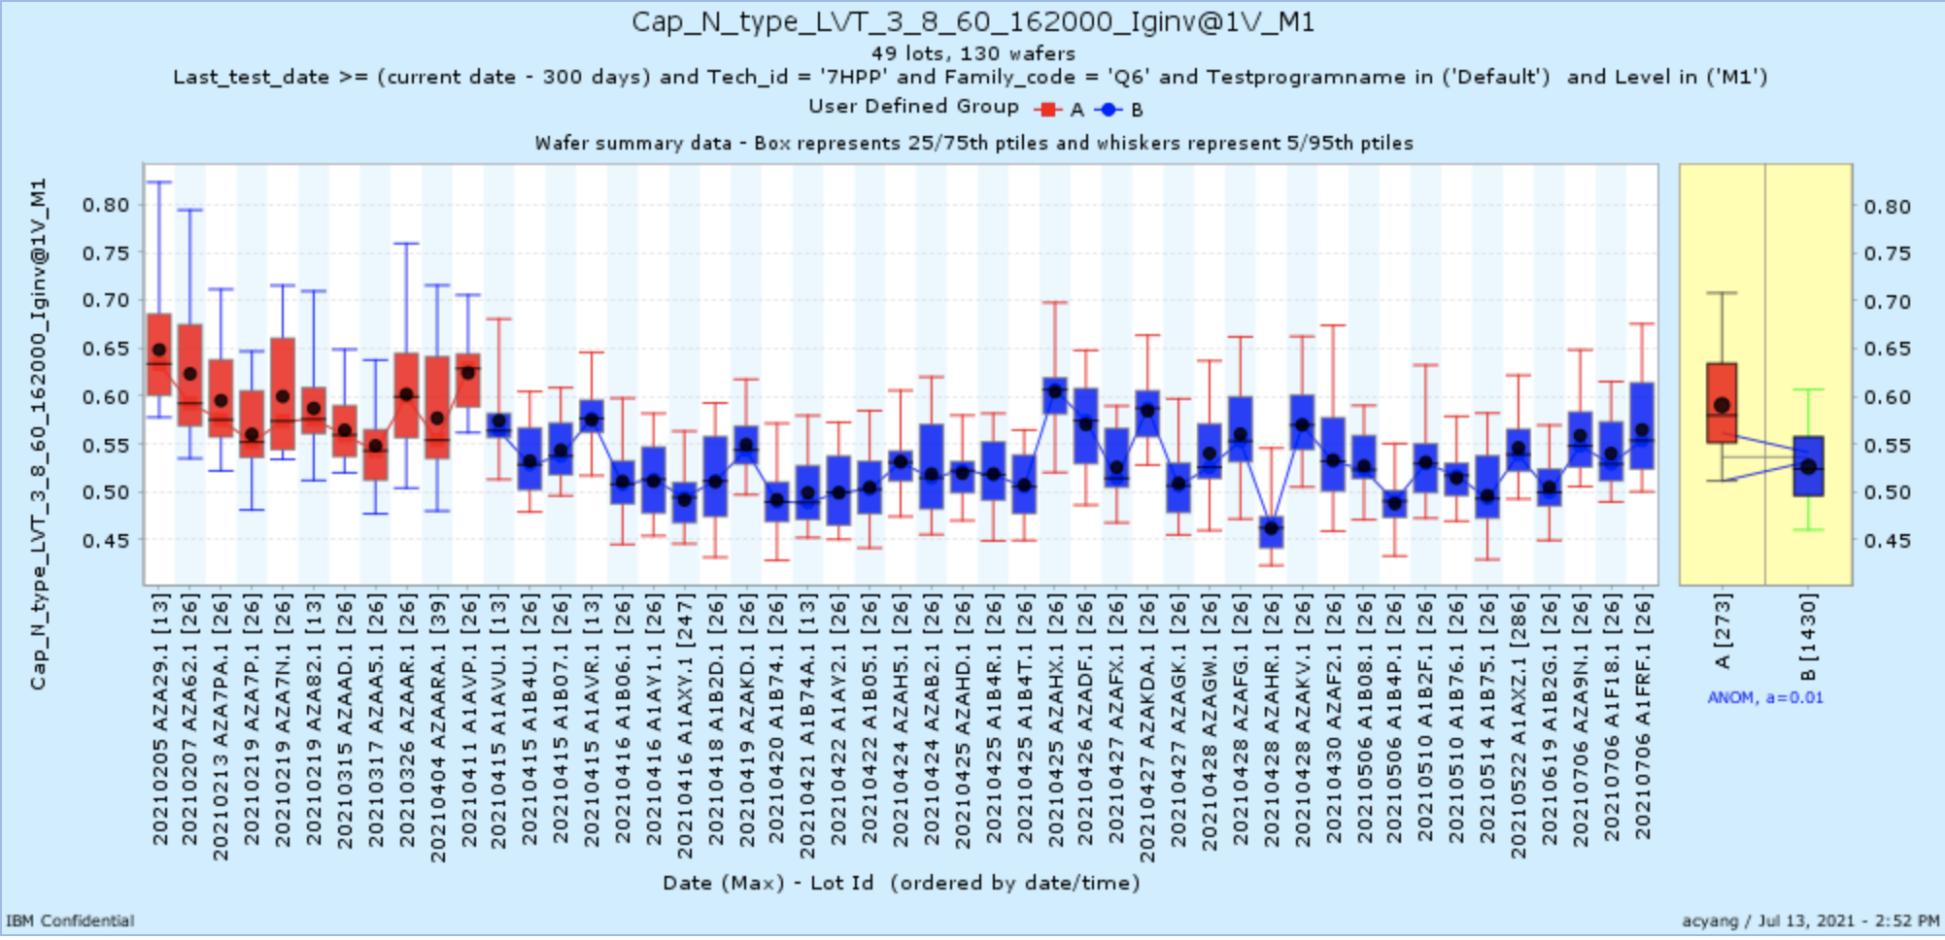
Cap_N_type_LVT_3_8_60_162000_Iginv@1V_M1

Slide 9
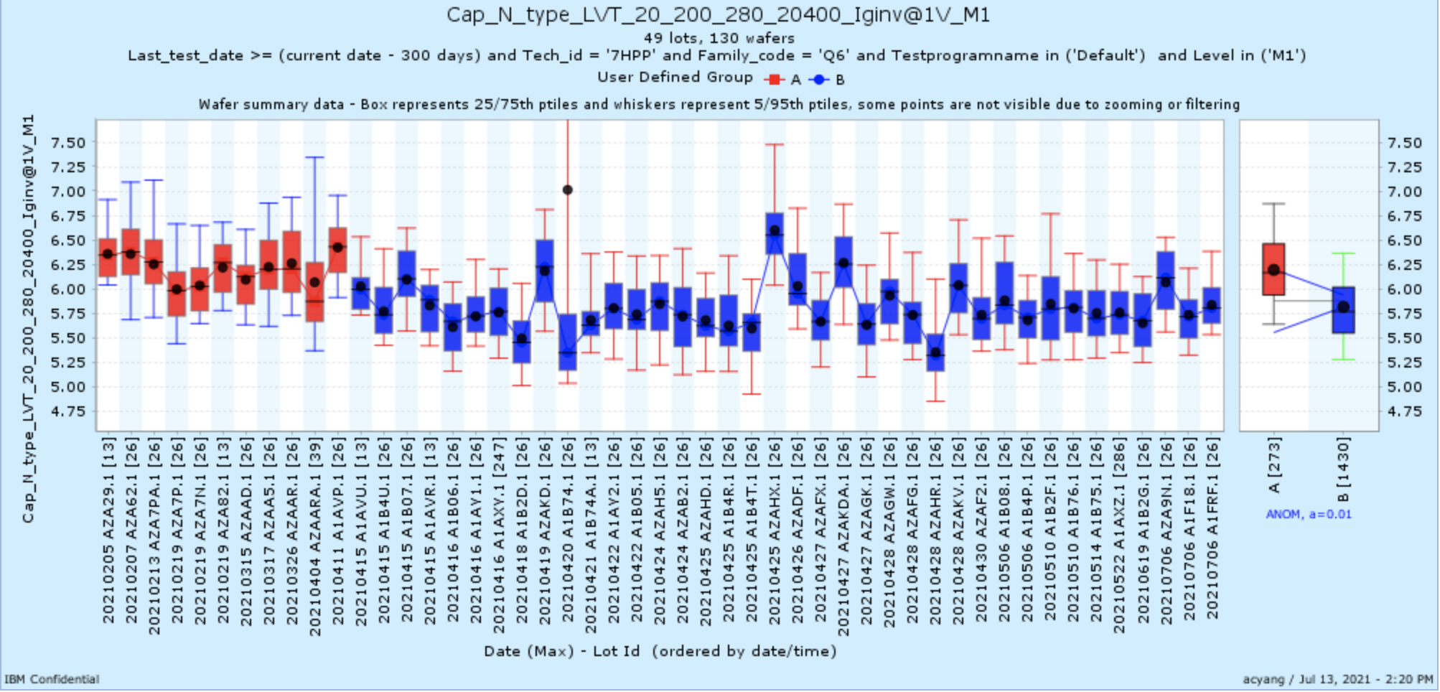
Cap_N_type_LVT_20_200_280_20400_Iginv@1V_M1

Slide 10
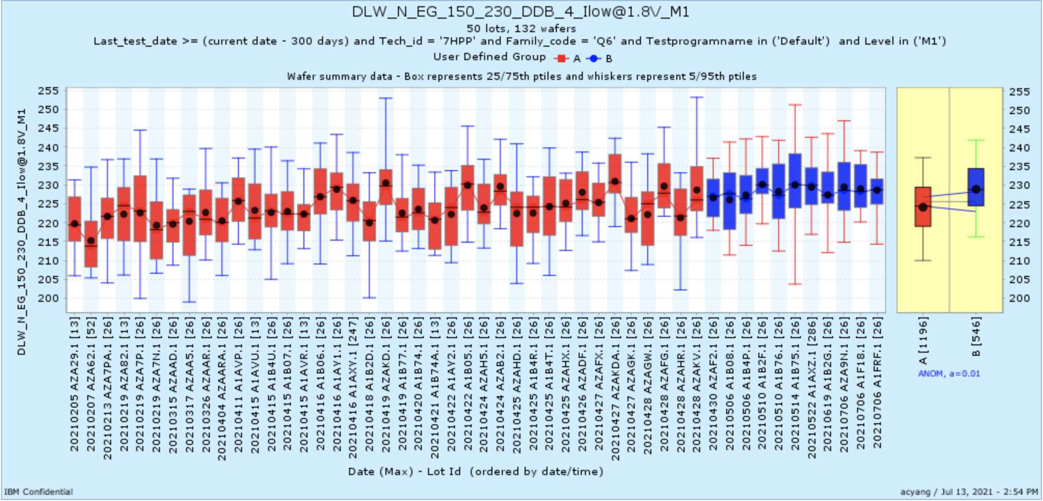
DLW_N_EG_150_230_DDB_4_Ilow@1.8V_M1

Slide 11
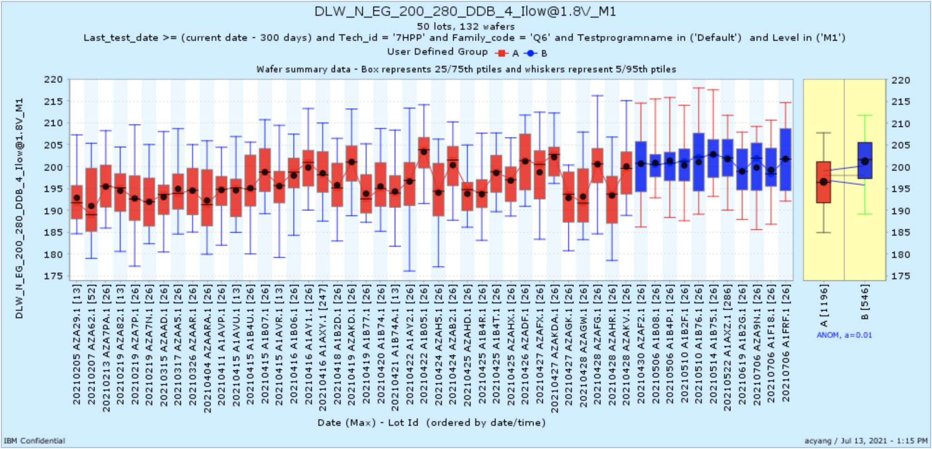
DLW_N_EG_200_280_DDB_4_Ilow@1.8V_M1

Slide 12
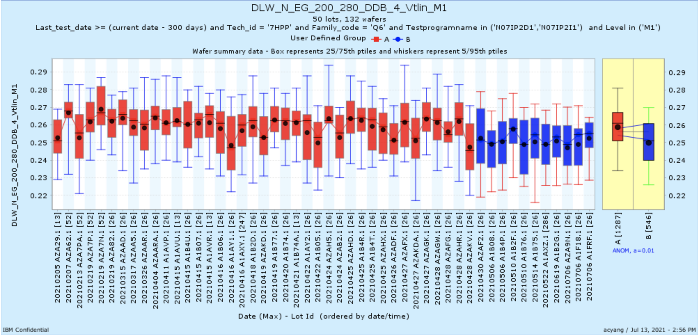
DLW_N_EG_200_280_DDB_4_Vtlin_M1

